Slide 1

PROCESS FLOW
Notes:
I will take you through the process flow of assessment and accreditation of civil service training institutions

Slide 2





PROCESS FLOW
Onsite Assessment
Post successful Desktop Assessment, an on-site assessment will be scheduled by the desktop assessor
Registration
  Institute will register itself on the NSCSTI Portal by the following two methods:
  METHOD 1: Dropdown
  METHOD 2: Signup
Application Filling
  Application Form (Part A): The application form contains 86 questions.
  National Standards (Part B): The National Standards is bifurcated into eight pillars consisting of 59 objective type questions.
Desktop Assessment
  Desktop assessor will review application based on enclosed documents
Certificate Generation
Notes:
The process flow is divided into 5 stages i.e. registration stage, application filling, desktop assessment, onsite assessment and certificate generation stage.

Slide 3
STAGE 1:REGISTRATION
Notes:
First stage is registration

Slide 4
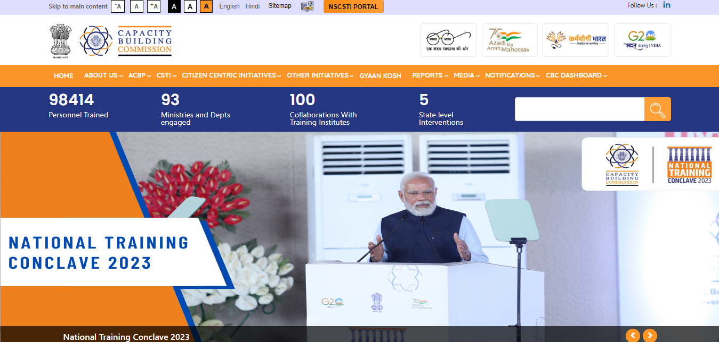
STEPS FOR REGISTRATION
To initiate registration, go to the Capacity Building Commission (CBC) website via www.cbc.gov.in, then click on the NSCSTI portal tab.
Notes:
Institute will go to the Capacity Building Commission website via www.cbc.gov.in and click on ‘NSCSTI Portal’ tab.

Slide 5
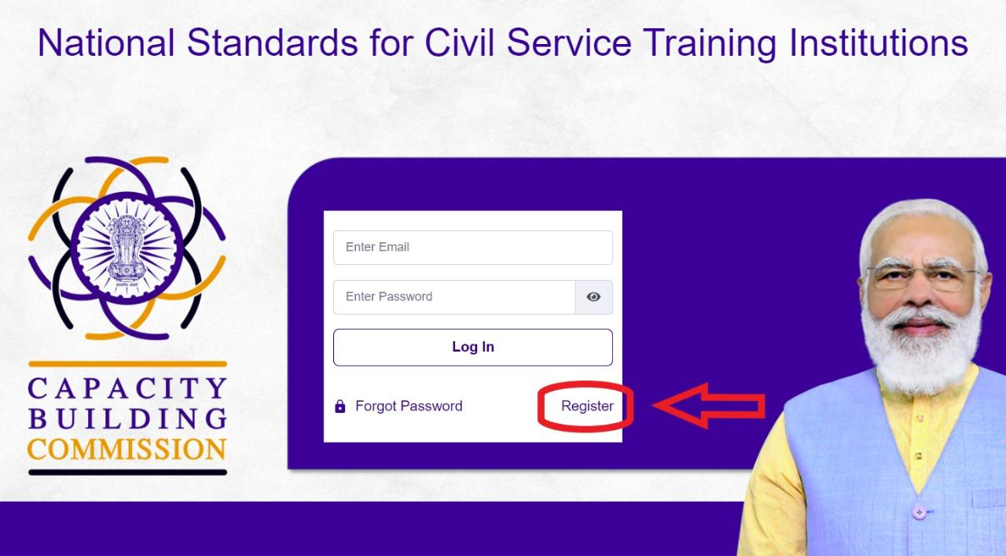
STEPS FOR REGISTRATION
The NSCSTI tab will redirect to the home page of the portal.
The institute will register itself by clicking on the register button on the homepage.
Notes:
This tab will redirect institute to the home page of the portal where the institute can register by clicking on the register button.

Slide 6
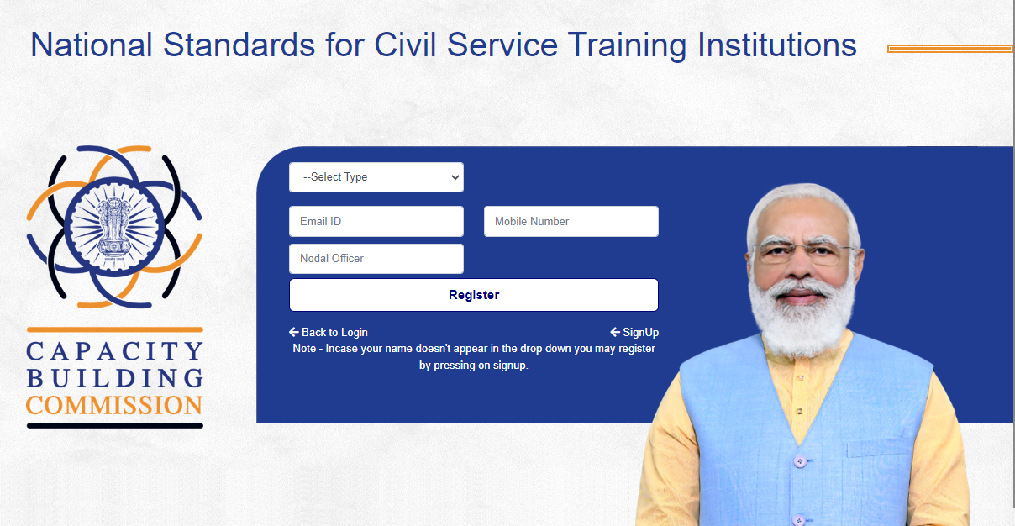
REGISTRATION-DROPDOWN
The institute is required to select its type (Central Ministry Institution or State Institution) from the drop-down list and enter the email ID, mobile number, and name of the Nodal Officer. The same details will be used for future communications.
In case the institute name is not in the drop-down list. The institute can register by clicking on the signup button.
Notes:
To initiate the registration process, institute can select its name from the dropdown list. In case the institute’s name is not available in the drop-down list, Registration can be done through ‘Signup’ button.

Slide 7
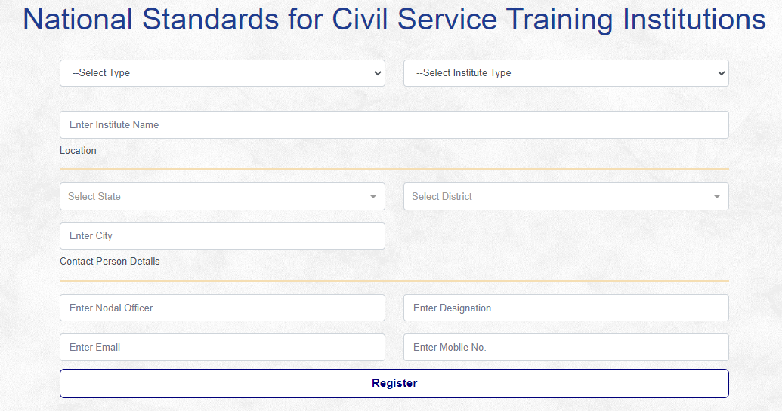
REGISTRATION-SIGNUP
A signup form will appear.
Notes:
On clicking Sign up button, A form will appear as visible on the screen, Institute can fill in the required details and click on the Register button.

Slide 8
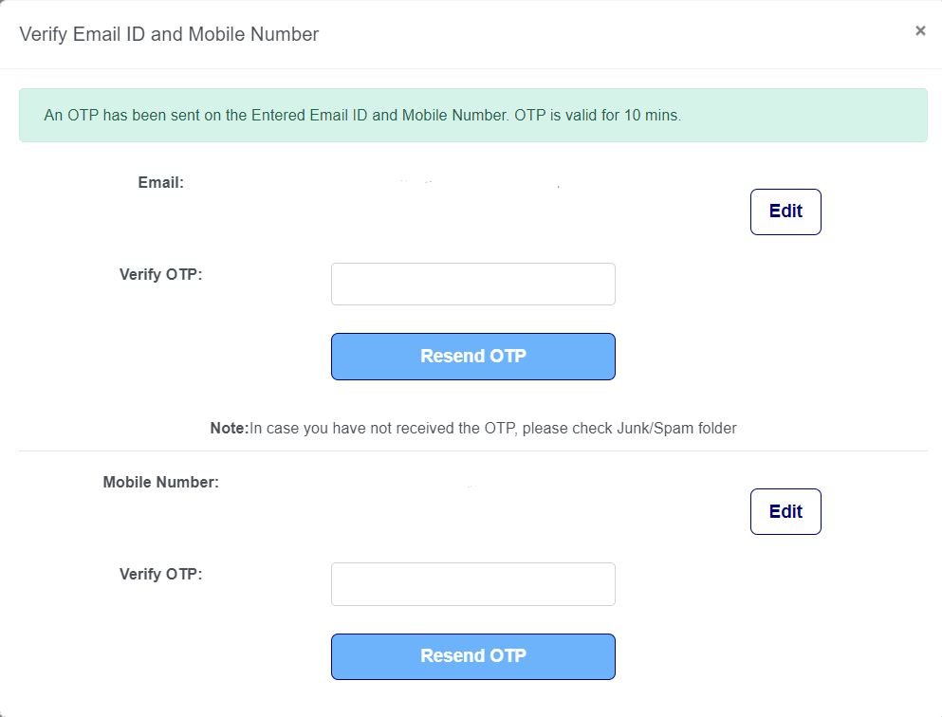
STEPS FOR REGISTRATION
Registration will be authenticated by dual verification through OTP sent on the registered Email ID and phone number which will only be valid for 10 mins.
Notes:
Registration will be authenticated by dual verification through OTP sent on the registered Email ID and phone number.

Slide 9
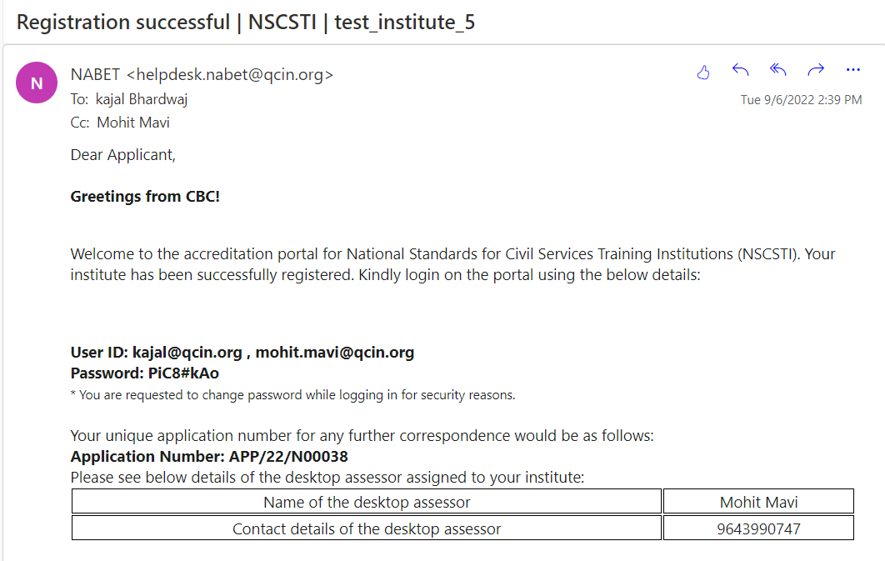
STEPS FOR REGISTRATION
Once the registration is completed, CBC is required to approve it.
Post approval, the institute can log in using the credentials received on the registered email ID mentioning the unique application number, user ID, password, and name & contact details of the desktop assessor.
Notes:
Registration will be successful subject to CBC Approval.
Post Successful Registration, institute will receive an Email intimation with details on login credentials, Unique Application number, name and contact number of the desktop assessor.

Slide 10
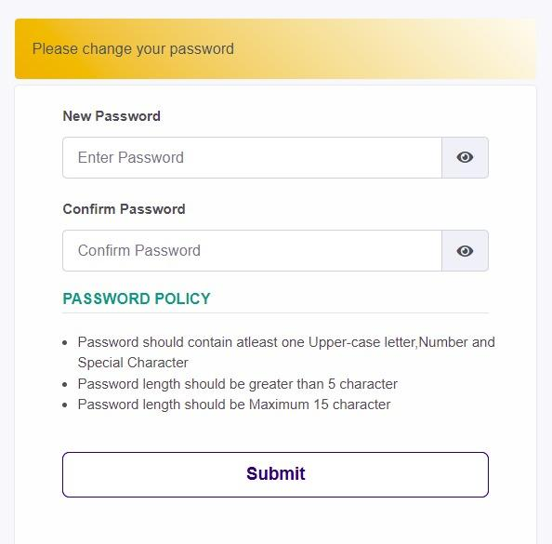
STEPS FOR REGISTRATION
The institute will log in using the login credentials sent on the registered e-mail id by the institute, upon which it will be redirected to a pop-up window where it will be asked to reset the password for security reasons.
At each stage, the institute will receive an email related to the status of the application.
Notes:
Institute will log in to the portal with the credentials shared on the registered email id and is required to reset the password for security reasons.

Slide 11
STAGE 2:APPLICATION FILLING
Notes:
Now, I would be talking about Application filling process

Slide 12
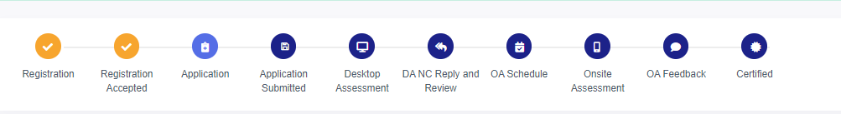
APPLICATION FILLING
The institute will get a time period of 30 days to fill the application.
Notes:
A progressive flowchart of the stages can be seen on the institute login page, The completed stages are tick marked for reference.
The institute will get 30 days time period to submit the application.

Slide 13
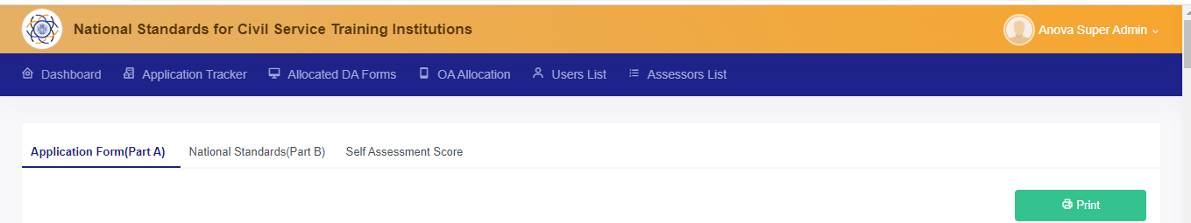
APPLICATION FILLING
The Application is divided into two parts i.e. Part A of the Application Form and Part B of the National Standards.
All the fields in both the parts are mandatory.
Notes:
The Application is divided into two parts- Application Form (Part A) and National Standards Form (Part B). All the fields in both parts are mandatory.

Slide 14
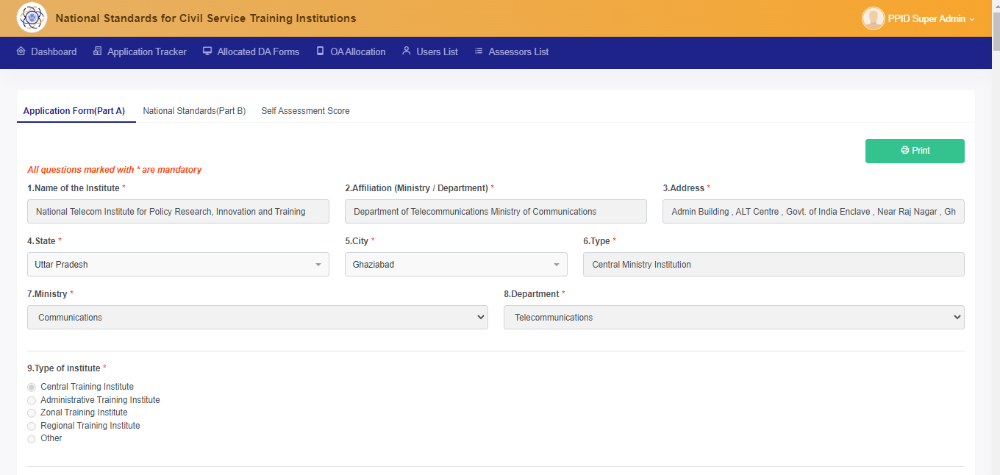
PART A- APPLICATION FILLING
Application Form (Part A) contains 86 questions on demographic details, faculty information, offline and online training conducted, funding & expenditure of the institute etc.
Notes:
Application form (Part A) contains 86 questions related to demographic details and other functional aspects of the institute.

Slide 15
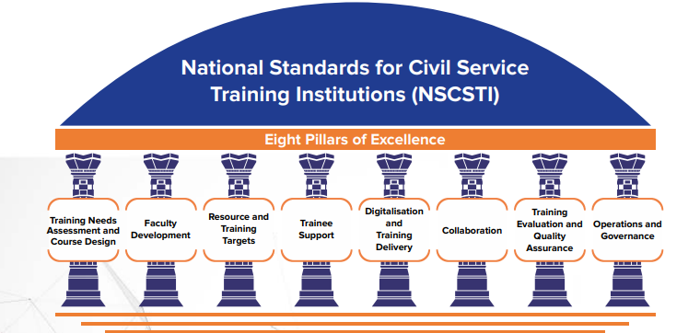
PART B- APPLICATION FILLING
National Standards (Part B) comprises 8 pillars of excellence
Notes:
National Standards Form (Part B) comprises 8 pillars of excellence. Namely, Training Needs Assessment and course design, Faculty Development, Resource &Training Targets, Digitalisation and Training delivery, Trainee Support, Collaboration, Training evaluation & Quality Assurance and Operations and Governance.

Slide 16
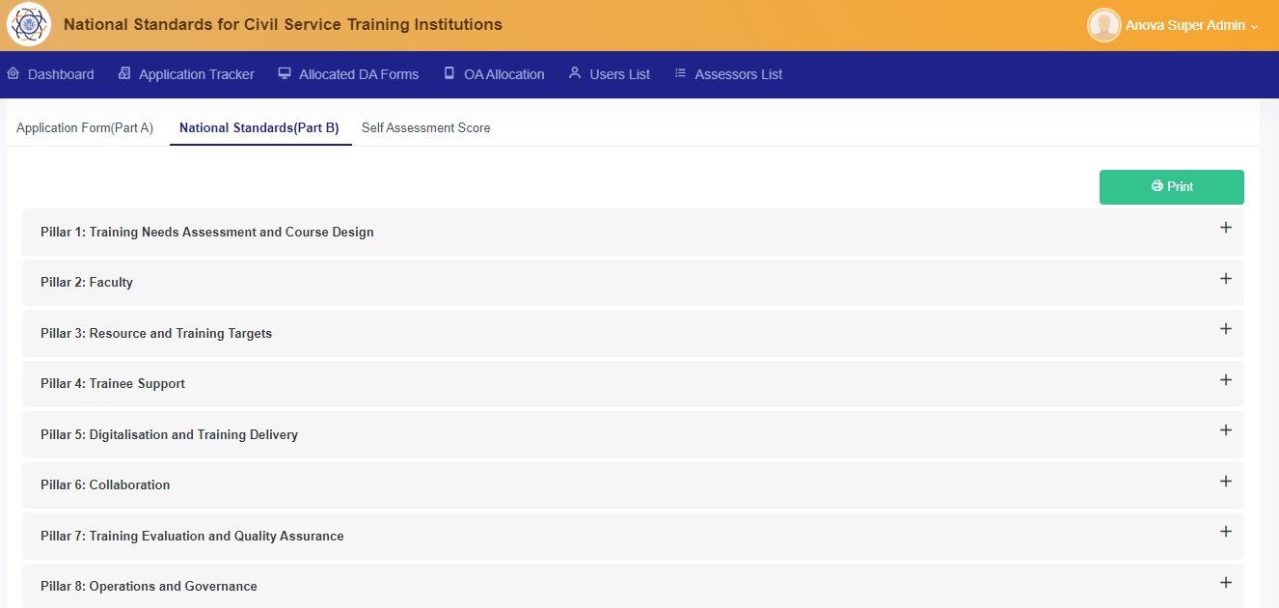
PART B- APPLICATION FILLING
These 8 pillars of excellence are bifurcated into 59 metrics.
16
Notes:
These 8 pillars of excellence are further bifurcated into 59 metrics.

Slide 17
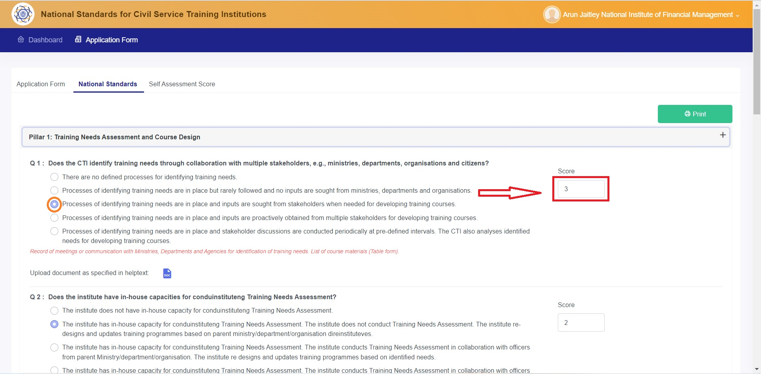
PART B- APPLICATION FILLING
Institute will be scored for every level selected for each metric.
The Institute is required to upload documentation supporting their claims in each metric.
Doc Upload Icon
Notes:
Institute will be scored on all the 59 metrics for every level selected. It is also required to upload supporting documents by clicking on the Document upload icon.

Slide 18
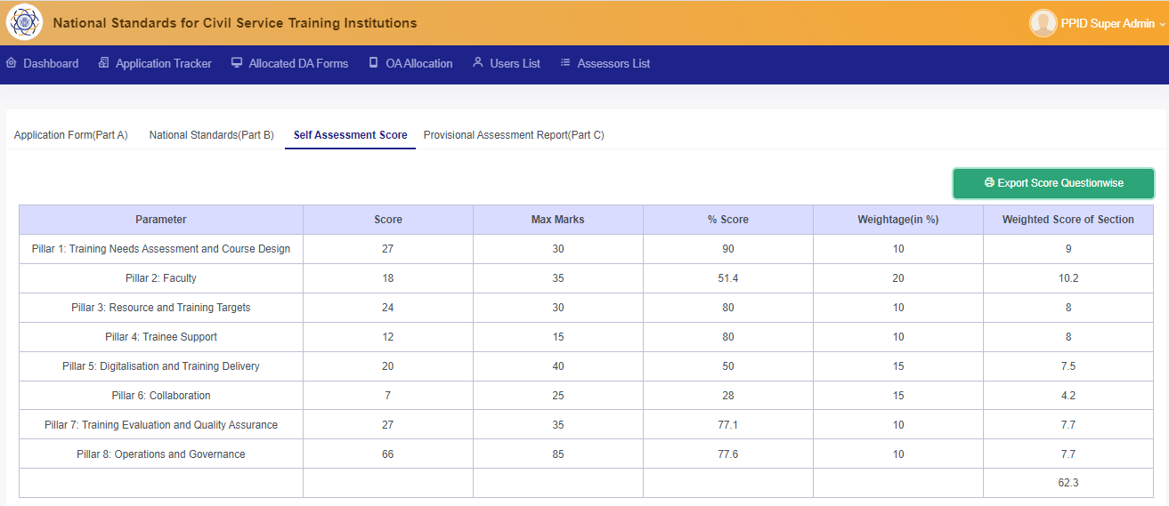
SELF- ASSESSMENT SCORE
Once the institute submits Part B of the application, a Self-assessment score will be generated for the institute.
Notes:
After submission of the application, a self-assessment score will be generated for the institute as seen on the screen.

Slide 19
STAGE 3: DESKTOP ASSESSMENT
Notes:
Now, I would be talking about Desktop Assessment stage

Slide 20
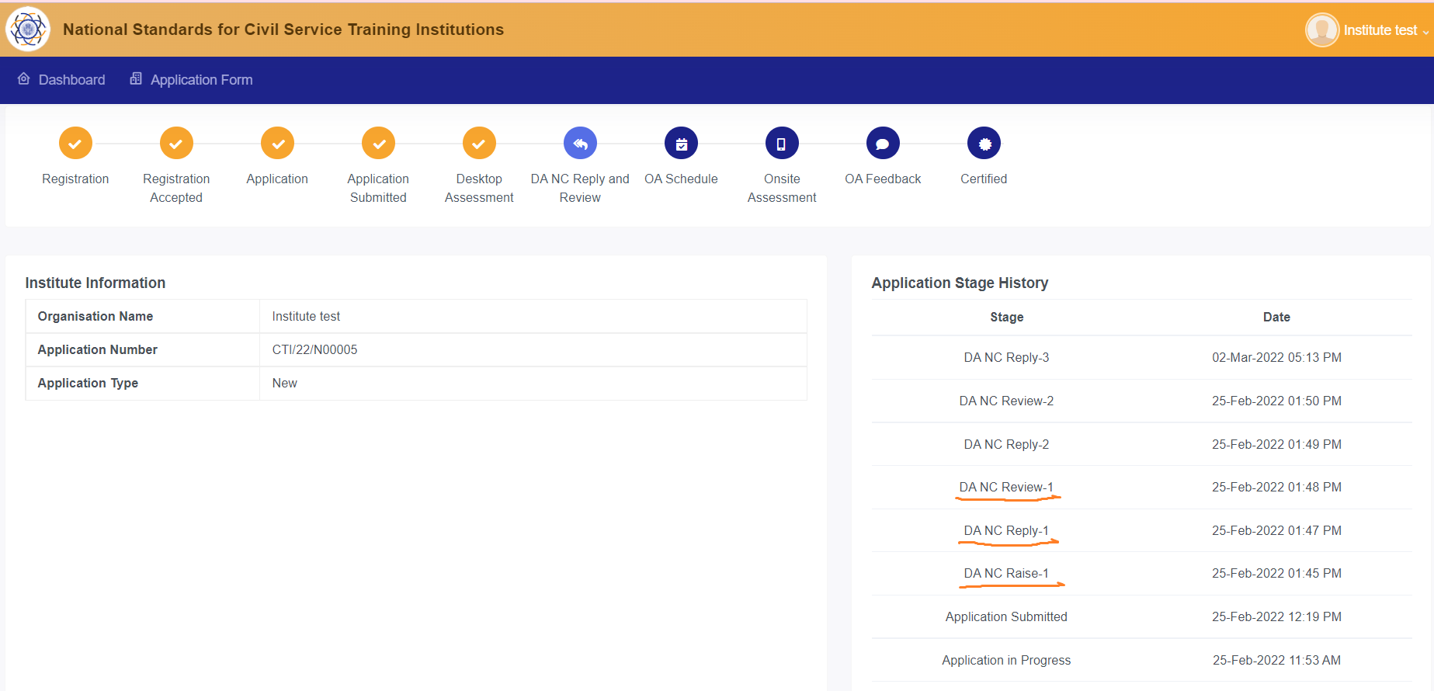
DESKTOP ASSESSMENT
Once an application is submitted, desktop assessor will review each question based on the documents submitted by the institute.
The application will move to Desktop Assessment stage, where Non-Conformities will be raised by desktop assessor in case documents attached are found to be incomplete or unsatisfactory.
Notes:
In Desktop Assessment stage, desktop assessor will check the completeness of the documents submitted by the institute as per the Supporting Document checklist provided by CBC. Non-Conformities will be raised by the desktop assessor in case documents attached are found to be incomplete.

Slide 21
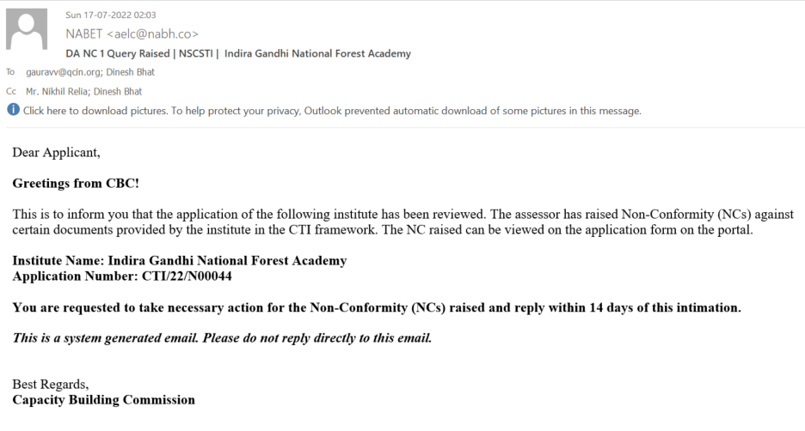
DESKTOP ASSESSMENT – NC Raised
Institute will receive an intimation mail, once NCs is being raised by the Desktop Assessor on the portal.
Notes:
Institute will receive an Email Intimation for the Non Conformity raised by the desktop assessor.

Slide 22
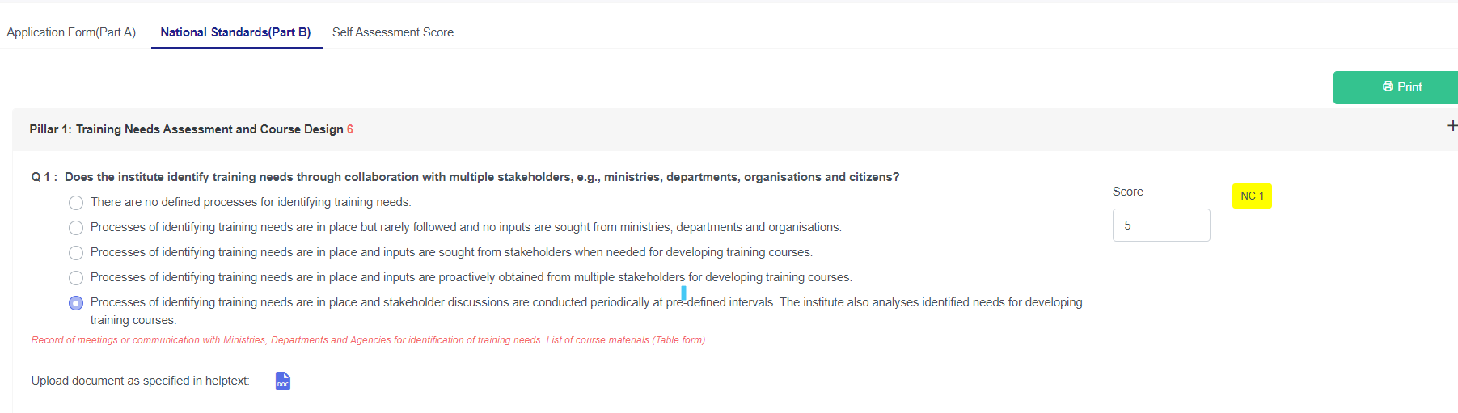
DESKTOP ASSESSMENT- NC Raised
Institute can check the Non-Conformities raised by clicking on the NC tab at the right side corner of each metric.
Notes:
These Non-Conformities can be seen by the institute by clicking on the NC tab.

Slide 23
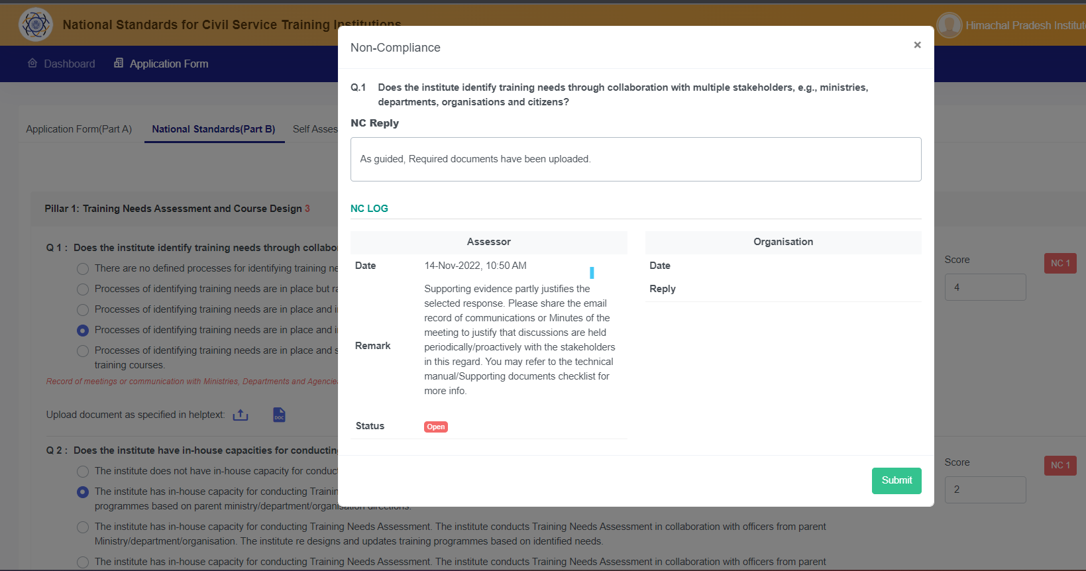
DESKTOP ASSESSMENT- NC REPLY
The institute will be required to provide a satisfactory reply against the NC raised.
Institute may upload additional documents against the NC raised to justify the response.
Notes:
For each Non-Conformity raised, institute is required to provide a satisfactory reply along with additional documents to justify the level selected.

Slide 24
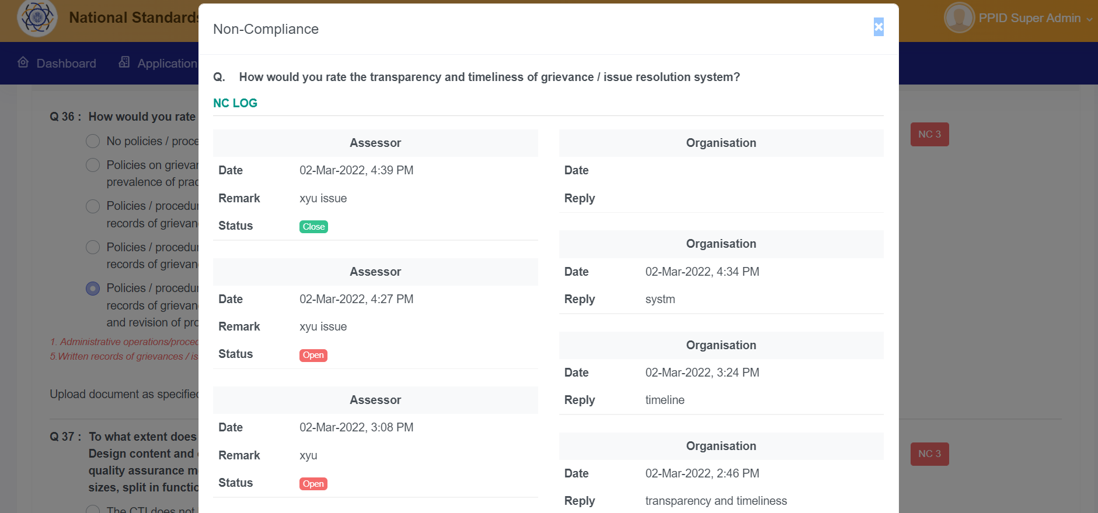
DESKTOP ASSESSMENT- NC LOG
NC tab can be clicked to view NC log.
Notes:
NC log for every metric can be seen by clicking on the NC tab, which shows the details of the communication between the Desktop Assessor and the institute.

Slide 25
DESKTOP ASSESSMENT
Once Non-conformity against all metrics is closed, the desktop assessor will accept the desktop assessment.
Post-acceptance of the desktop assessment following reports will be generated:
Desktop assessment Report
1.
2.
NC log Report
Provisional way forward Report
3.
Notes:
Once all the Non-conformities are closed, the Desktop assessment will be accepted. 3 reports will be generated namely Desktop Assessment Report, NC Log Report, and Provisional way forward Report .

Slide 26

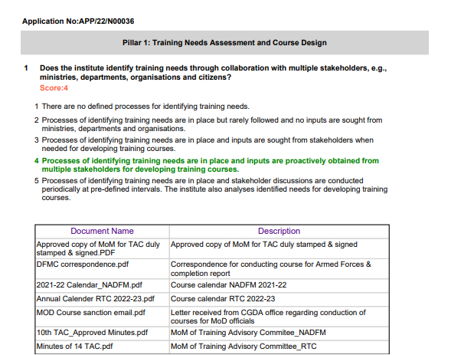
DESKTOP ASSESSMENT REPORT
Desktop Assessment report will describe the supporting documents submitted by the institute against each metric.
Notes:
The Desktop Assessment report will provide information on the level selected along with the score and list of supporting documents uploaded by the institute

Slide 27

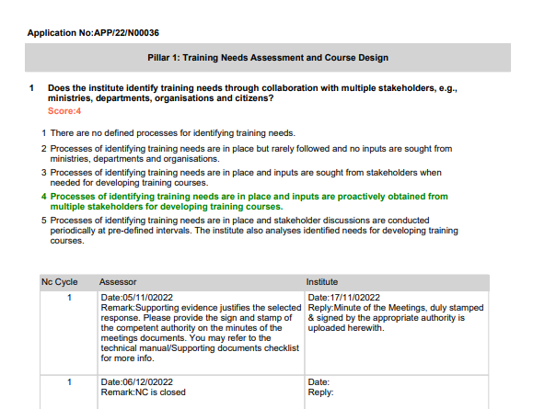
DESKTOP ASSESSMENT- NC LOG REPORT
NC log report provides details of all the communications held between the desktop assessor and the institute.
Notes:
NC log report provides details of all the communications held between the desktop assessor and the institute.

Slide 28

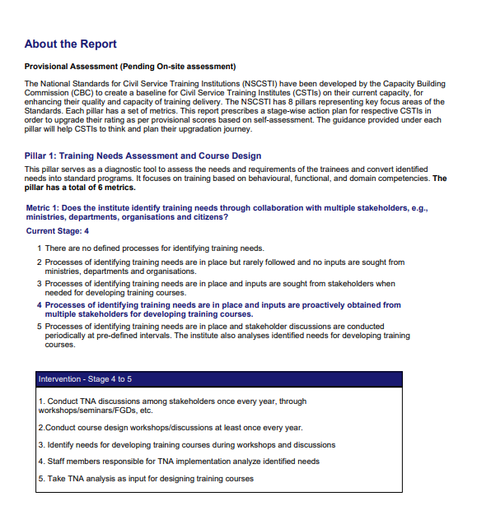
PROVISIONAL WAY FORWARD REPORT
Provisional way forward report will guide the institute on its current capacity and prescribe stage wise action plan in order to upgrade its ranking as per provisional scores based on self-assessment
Notes:
Provisional way forward report will guide the institute on its current capacity and prescribe stage wise action plan in order to upgrade its ranking as per provisional scores based on self-assessment

Slide 29
STAGE 4:ON-SITE ASSESSMENT
Notes:
Now, I would be talking about On site assessment stage

Slide 30
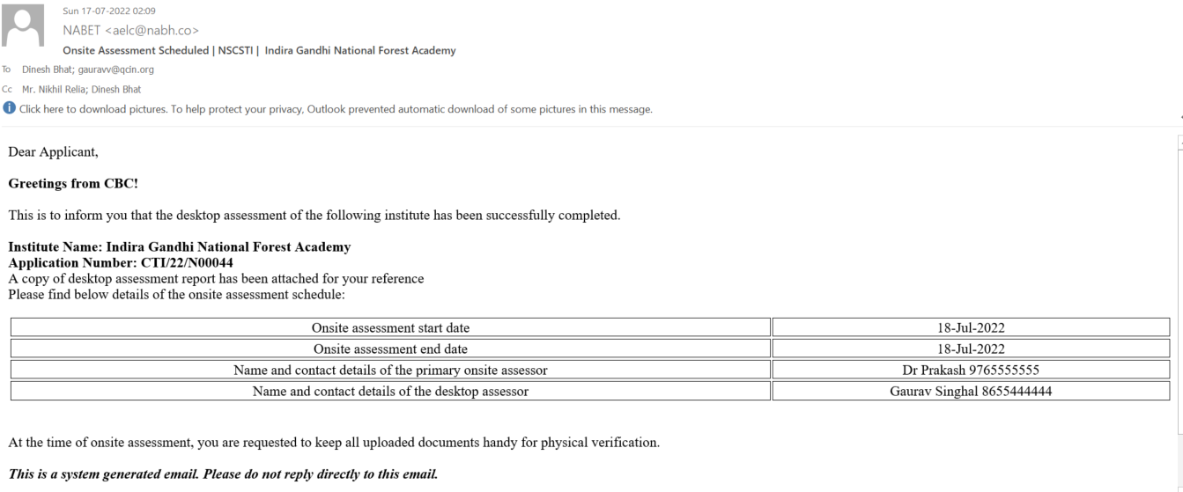
ON-SITE ASSESSMENT SCHEDULING
Post desktop assessment, On-site assessment will be scheduled in consultation with institute and CBC.
Details of the onsite assessment will be intimated to the institute via email.
It would comprise of onsite assessment dates, name & contact details of the onsite and desktop assessor
Notes:
An on-site assessment will be scheduled in consultation with the institute and CBC.
Details of the onsite assessment comprising onsite assessment dates, name & contact details of the onsite and desktop assessor will be intimated to all the stakeholders including CBC, Onsite Assessors, Desktop Assessors and the Institute via email.

Slide 31
ON-SITE ASSESSMENT
Timeline for scheduling onsite assessment will be 30 days from acceptance of desktop assessment.
Onsite Assessment would be carried by the team of assessor comprising Primary and Secondary Assessor empaneled by Assessment Agency with approval of Capacity Building Commission .
Empaneled assessors of Assessment Agency along with the Assessment Agency Secretariat would visit institute and verify the documents on the scheduled date.
Notes:
Onsite Assessment will be carried by the team of assessor comprising Primary and Secondary Assessor empaneled by Assessment Agency with approval of CBC.
The empaneled onsite assessors along with the Assessment agency Secretariat will physically visit the institute and verify the documents.

Slide 32
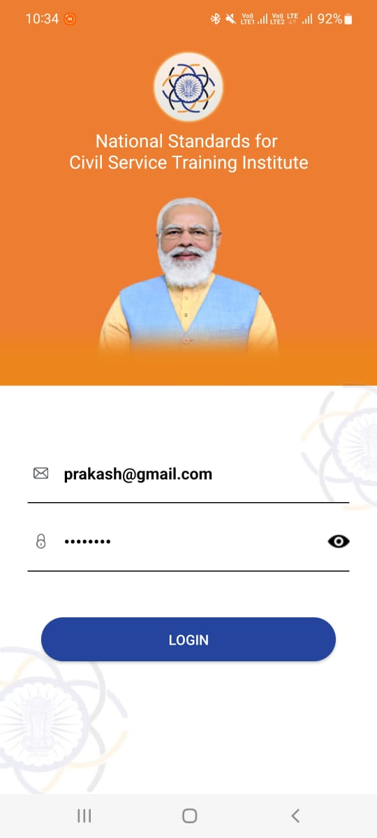
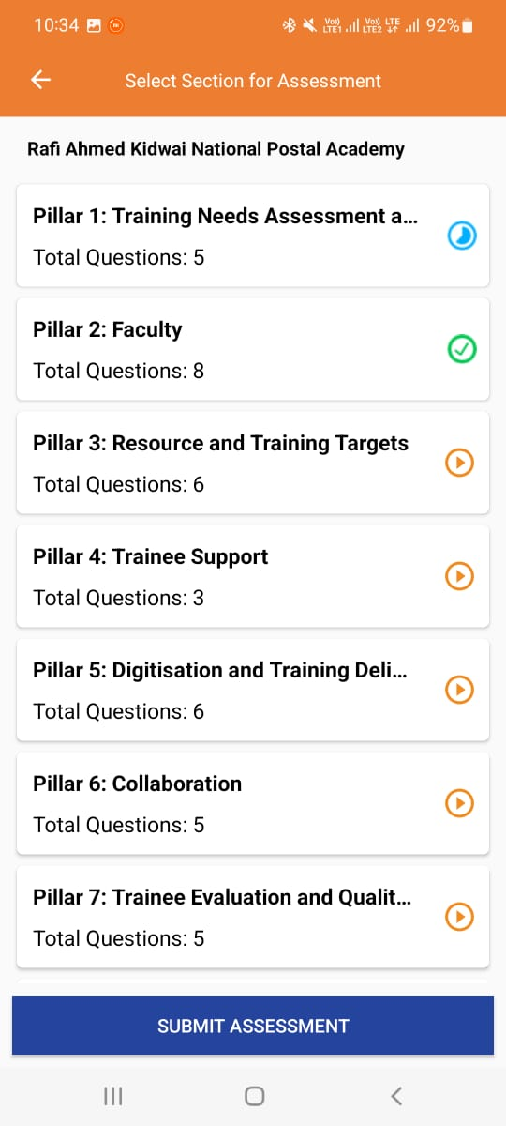
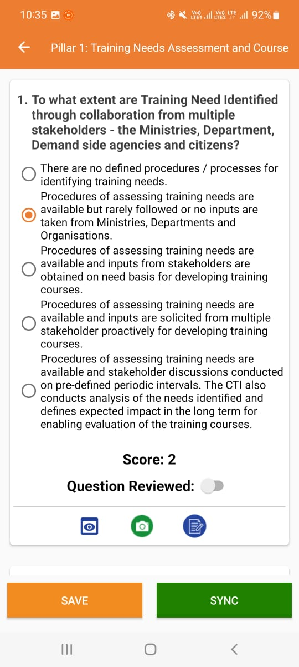
ON-SITE ASSESSMENT (MOBILE APPLICATION)
Onsite assessment will be carried out on Mobile Application- NSCSTI
Log in credentials for the mobile application will be shared with onsite assessor via email.
Notes:
Onsite assessment will be carried out on Mobile Application (NSCSTI) available on play store.
Log in credentials for the mobile application will be shared with the primary assessor.

Slide 33
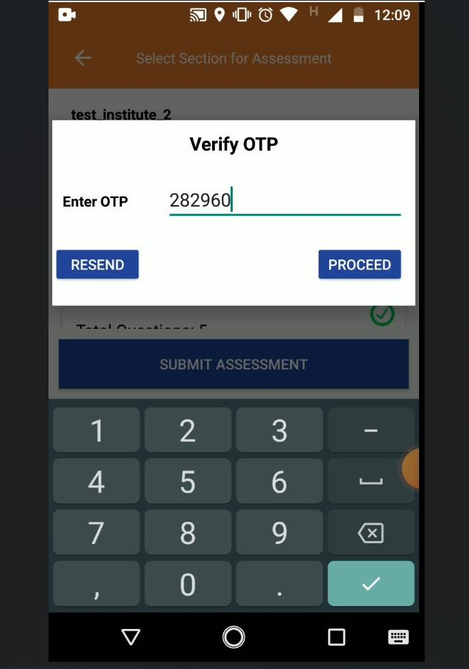
COMPLETITION OF ON-SITE ASSESSMENT
A closure meeting will be done between institute & Site assessor before completion of Assessment.
Post completion of the Onsite Assessment, An OTP based authentication will be done.
Institute has to share the OTP with the Site Assessor to complete assessment process on the mobile application.
Notes:
To complete the assessment process of the institute, the nodal officer is required to share the OTP received on his registered number with the onsite-assessor.

Slide 34
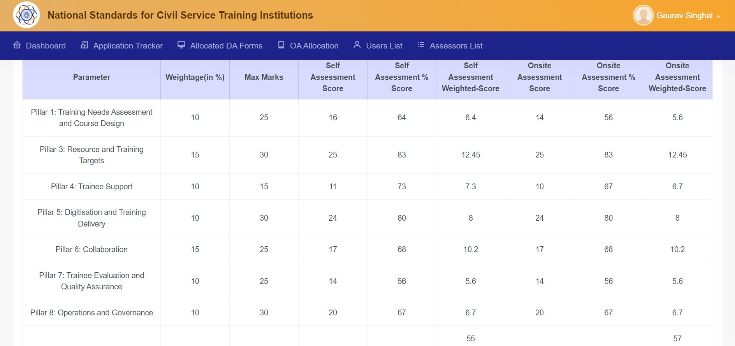
CUMULATIVE SCORE SHEET
Post-competition of the onsite assessment, a Cumulative Score Sheet will be generated based on self-assessment and onsite assessment scores.
Notes:
Post-competition of the onsite assessment, a cumulative score sheet would be generated which will include the self-assessment and onsite assessment score.

Slide 35
ONSITE ASSESSMENT REPORT
Post Onsite Assessment, following reports will be generated for the Institute:
Onsite Assessment Report
1
2
Final Way Forward Report
Notes:
Post Onsite Assessment, 2 reports will be generated for the Institute i.e. Onsite Assessment Report and Final way forward Report

Slide 36
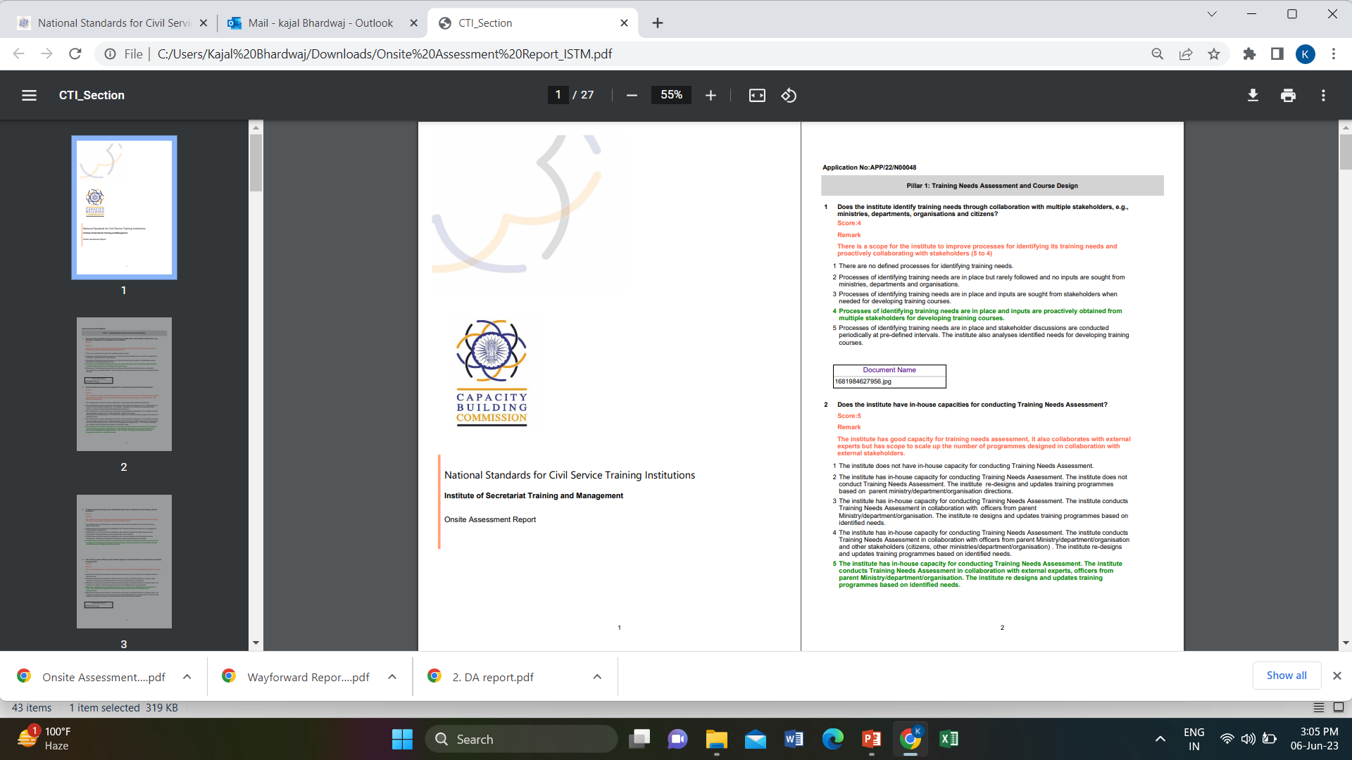
ONSITE ASSESSMENT REPORT
An Onsite Assessment Report and Final Way Forward Report will be generated for the Institute after completion of the onsite Assessment.
Onsite assessment report comprises the onsite assessment score, remarks of assessors and additional documents uploaded at the time of assessment in reference to the metric.
Notes:
The Onsite Assessment Report will comprise information related to the on-site assessment score, onsite assessor remarks, and additional documents (if any) provided by the institute at the time of onsite assessment.

Slide 37
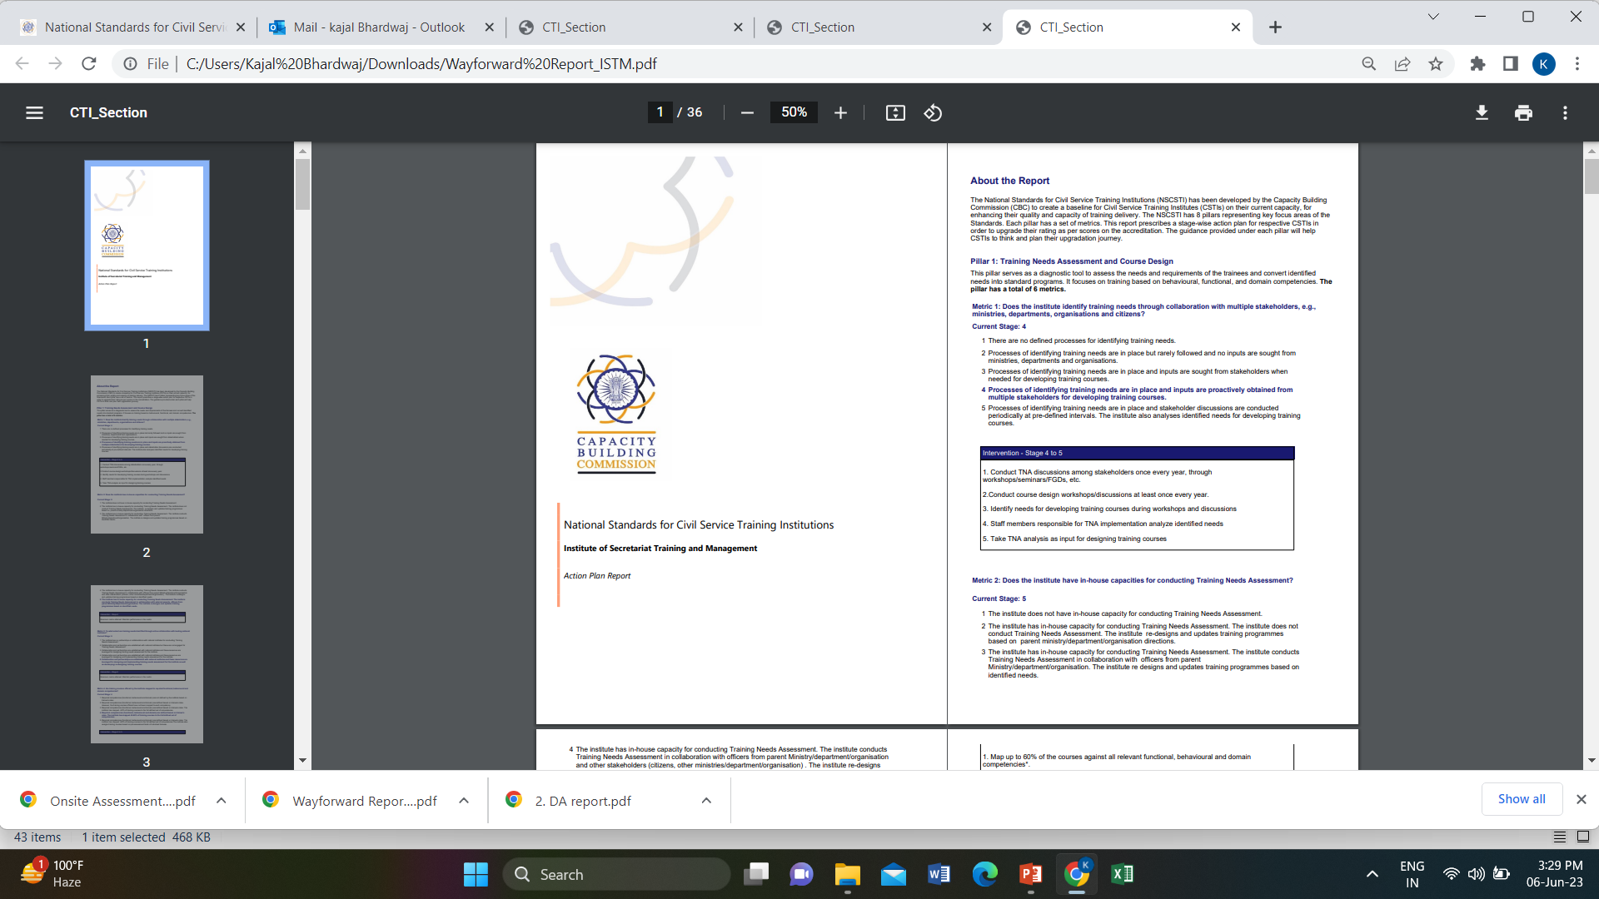
FINAL WAY FORWARD REPORT
The Final way forward report prescribes a stage-wise action plan/interventions to institute for upgrading their rating in the metric in future. The guidance under each pillar will help CSTIs to think and plan their journey.
Notes:
Final Way Forward Report will guide the institute on its current capacity and prescribe stage wise action plan in order to upgrade its ranking as per final scores based on onsite-assessment

Slide 38
STAGE 5:
CERTIFICATE GENERATION
Notes:
Now, I will be talking about Certification stage

Slide 39

CERTIFICATION
On the basis of onsite assessment report, the grades will be awarded to the institute as per the below criteria based on the approval from Capacity Building Commission.
Certificate of Accreditation will be issued to the Institute scoring above 40.
Marks (range) | Grade awarded | Star rating
≥89-100 | Outstanding/ सर्वोत्कृष्ट
≥77-89 | Excellent/ अति उत्कृष्ट
≥65-77 | Very Good/ उत्कृष्ट
≥53-65 | Good/ अति उत्तम
40-53 | Fair/ उत्तम
Below 40 | No rating
Notes:
On the basis of onsite assessment score, the grades will be awarded to the institute as per the table shown on the screen.
Any institute scoring below 40 will not be awarded Certificate of Accreditation.

Slide 40
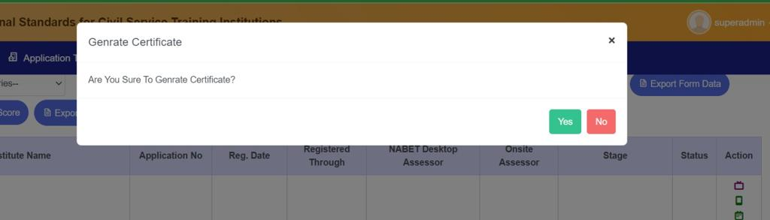
CERTIFICATION
Certificate will be issued with the approval of CBC
Notes:
The final approval of grades and certificate of accreditation for Institute will be given by Capacity Building Commission.

Slide 41

CERTIFICATION
The Certificate of Accreditation would be valid for a period of 2 years.
Notes:
Certificate of accreditation will be valid for a period of 2 years, A sample certificate can be seen on the screen

Slide 42
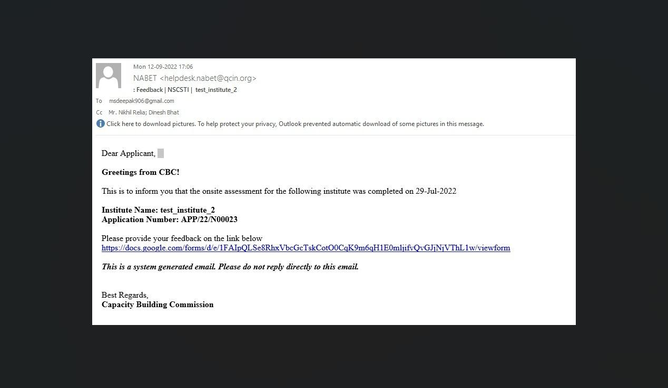
ASSESSMENT FEEDBACK
Post Onsite Assessment, a link would be sent to the institute for their valuable feedback.
Notes:
A link will be shared with the institute for their valuable feedback post-onsite assessment.

Slide 43
ADDITIONAL INFORMATION
Notes:
Now I will be sharing some additional information

Slide 44
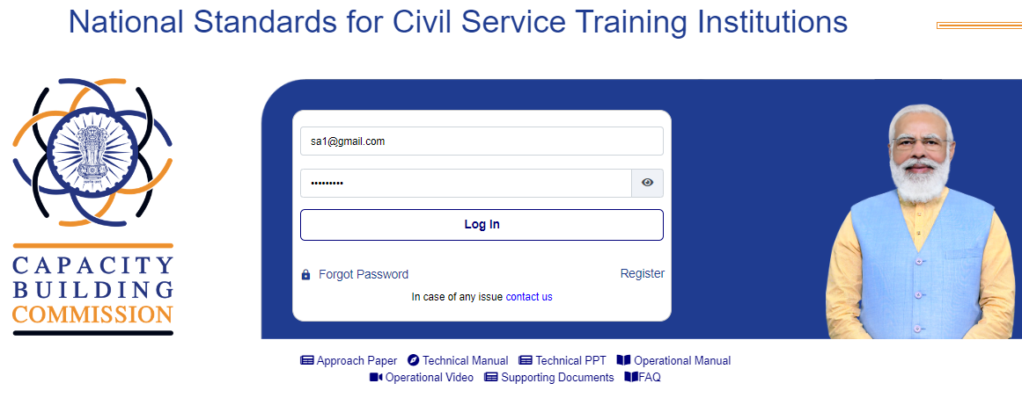
IMPORTANT LINKS
Important documents such as Approach paper, Operational Manual, Technical Manual, supporting documents and FAQs are available for the purpose of downloading.
Notes:
Institute may download the Approach paper, Technical Manual, Technical PPT, Operational Manual, Operational Video, Supporting Documents and FAQs from the home page of the NSCSTI portal for their reference.

Slide 45
ABOUT DOCUMENTS
1
Approach paper consists of the objectives of Mission Karmayogi
Technical Manual consists detailed information about 59 metrics
2
Technical PPT consists detail explanation of 59 metrics
3
4
Operational Manual consists of the assessment process
Operational Video consists of details on the assessment and accreditation process
5
Supporting documents consist of list of supporting evidences against each metric
6
7
FAQs are the frequently asked questions
Notes:
The approach paper consists of the objectives of mission Karmayogi
The technical manual consists of detailed information about 59 metrics
Technical PPT consists detail explanation of 59 metrics
The operational manual consists of the assessment process,
Operational Video consists of details on the assessment and accreditation process
The supporting documents consist a list of supporting evidence against each metric
And The FAQs are the frequently asked questions.

Slide 46
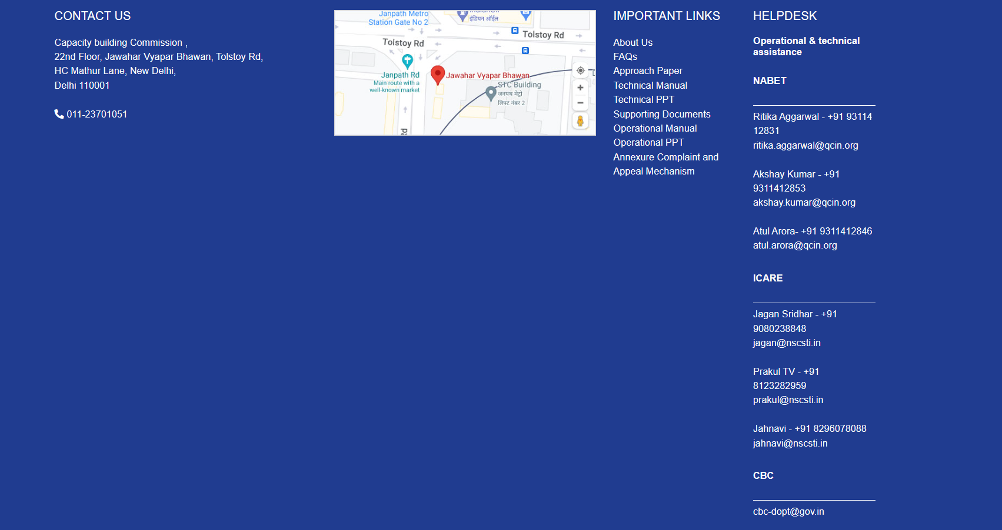
HELP DESK NUMBERS
Help Desk numbers are also available on the homepage of the NSCSTI Portal. Institute may reach out, to the capacity building commission also in case of any query.
Notes:
In addition, the institute may reach out to helpdesk numbers as seen on the screen in case of any query.

Slide 47
Thank you

