Slide 1


Unified New Age National Training Institutes
(UNNATI)
Guidebook

Slide 2
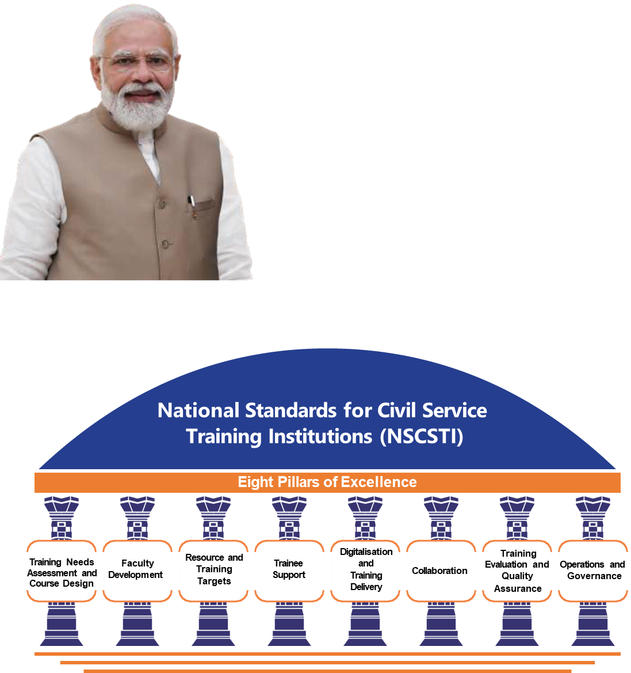
National Standards for Civil Service Training Institute 2.0
Unified New Age National Training Institutes
Nos. Metric:
5
Weightage:
10%
Nos. Metric:
5
Weightage:
20%
Nos. Metric:
6
Weightage:
15%
Nos. Metric:
3
Weightage:
5%
Nos. Metric:
5
Weightage:
15%
Nos. Metric:
5
Weightage:
15%
Nos. Metric:
6
Weightage:
10%
Nos. Metric:
8
Weightage:
10%

Slide 3
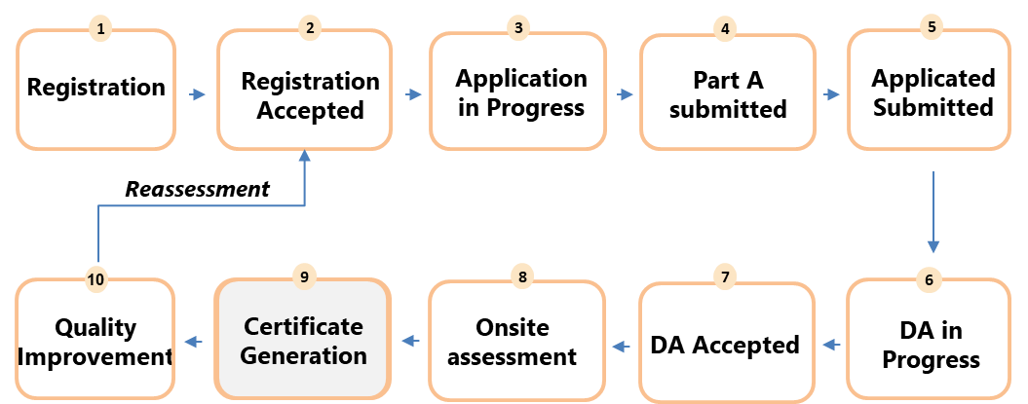
Accreditation Process Flow

Slide 4

Pillar 1: Training Needs Assessment and Course Design
This pillar assesses the institute on the presence of SOPs/ Manuals for conducting TNA, presence of in-house capacity for TNA, extent of collaboration with stakeholders, conduction of course-competency mapping, and presence of SOPs for tenure based/on-demand courses.
No of Metrics: 5
Weightage: 10%

Slide 5
Metric 1
Does the institute/Training directorate (as applicable) have in-house capacity to identify Training Needs?
Stage | Description | Marks
Stage 1 | No in-house capacity to conduct Training Needs Assessment | 0
Stage 2 | Has in-house capacity to conduct Training Needs Assessment. No inputs sought from the parent Ministry/Department/Organisation. | 2
Stage 3 | Has in-house capacity to conduct Training Needs Assessment: Inputs are sought from parent Ministry/Department/Organisations/Cadre controlling authority/General Administration Dept/Training Directorate on need basis. | 3
Stage 4 | Has in-house capacity to conduct Training Needs Assessment: Inputs are obtained from parent Ministry/Department/Organisations/Cadre controlling authority/General Administration Dept/Training Directorate for developing training courses at predefined intervals. The institute analyses identified needs, but no follow-up actions are undertaken. | 4
Stage 5 | Has in-house capacity to conduct Training Needs Assessment: Stakeholder discussions are conducted at predefined intervals. Conducts Training Needs Assessment in collaboration with officers from the parent Ministry/Department/Organisation and other stakeholders. The institute analyses identified needs and re-designs/updates training programmes. | 5

Slide 6
Metric 2
To what extent are the training needs identified through active collaboration with leading national/international institutes?
Stage | Description | Marks
Stage 1 | The institute has no partnerships or collaborations with national/international institutes. | 0
Stage 2 | Collaboration and partnerships are established with national/international institutes, but these are not engaged for Training Needs Assessment. | 2
Stage 3 | Collaboration and partnerships are established with national/international institutes, and these resources are leveraged for designing the Training Needs Assessment for the institute. | 3
Stage 4 | Collaboration and partnerships are established with national/international institutes and these resources are leveraged for designing and implementing Training Needs Assessment for the institute. | 4
Stage 5 | Collaboration and partnerships are established with national/ international institutes and these resources are leveraged for designing and implementing Training Needs Assessment for the institute as well as developing/ re-designing/ revising training courses. | 5

Slide 7

Metric 3
Are training courses offered by the institute/training directorate mapped as per Karmayogi Competency Model (KCM) for functional and behavioural competencies and domain competency?
Stage | Description | Marks
Stage 1 | Required competencies (functional, behavioural and domain) are not defined by the institute. | 0
Stage 2 | Required competencies (functional, behavioural and domain) are defined. The institute has mapped for <50% of training courses to the full defined set of competencies. | 2
Stage 3 | Required competencies (functional, behavioural and domain) are defined. The institute has mapped 50-70% of training courses to the full defined set of competencies. | 3
Stage 4 | Required competencies (functional, behavioural and domain) are defined based on the trainee's roles. The institute has mapped 70-90% of training courses to the full defined set of competencies. | 4
Stage 5 | Required competencies (functional, behavioural and domain) are defined based on the trainee's roles. The institute has mapped >90% of training courses to the full defined set of competencies. | 5

Slide 8
Metric 4
Does the institute/Training directorate have standard operating procedures for designing core courses in the last 2 years?
Example: Tenure-based training programmes like probationary courses, mid-career training programmes, etc.
Stage | Description | Marks
Stage 1 | Standard operating procedures are not available. | 0
Stage 2 | Standard operating procedures are in place and followed for designing <50% of core courses | 2
Stage 3 | Standard operating procedures are in place and followed for designing 50-70% of core courses. | 3
Stage 4 | Standard operating procedures are in place and followed for designing 70-90% of core courses. | 4
Stage 5 | Standard operating procedures are in place and followed for designing >90% of core courses. | 5

Slide 9
Metric 5
Does the institute/Training Directorate have standard operating procedures for designing in-service trainings, demand-based trainings, etc., in the last 2 years?
Stage | Description | Marks
Stage 1 | Standard operating procedures are not available. | 0
Stage 2 | Standard operating procedures are in place but followed for designing <50% of training courses | 2
Stage 3 | Standard operating procedures are in place but followed for designing 50-70% of training courses. | 3
Stage 4 | Standard operating procedures are in place and followed for designing 70-90% of training courses. | 4
Stage 5 | Standard operating procedures are in place and followed for designing >90% of training courses. | 5

Slide 10

Pillar 2: Faculty Development
This pillar entails procedures for appointing faculty and conduction of post appointment evaluation, Criteria for selecting guest faculty, Formal onboarding process, percentage of faculty certification, Inter and Intra faculty communication, and conduction of FDP and level of participation
No of Metrics: 5
Weightage: 20%

Slide 11
Metric 6
How are full-time faculty members selected and appointed to the institute?
Stage | Description | Marks
Stage 1 | The institute has no defined process for faculty selection and appointment, as all appointments are made by the Ministry/Department/Organisation/Cadre Controlling Authority. | 0
Stage 2 | The institute has a defined process for faculty selection and appointment but does not follow the process. | 2
Stage 3 | The institute has a defined process for faculty selection and appointment. The selection process engages an internal committee for screening of the faculty. The proposed list is shared with the Ministry/Department/Organisation/Cadre Controlling Authority for approval. The final approval for faculty selection rests with the parent Ministry/Department/Organisation/Cadre Controlling Authority. | 3
Stage 4 | The institute has defined a process for faculty selection and appointment. The selection process engages a committee with members internal to the institute as well as from the respective parent Ministry/Department/Organisation/Cadre Controlling Authority for screening of the faculty. The final approval for faculty selection is done based on the recommendation of the committee. | 4
Stage 5 | The institute has defined a process for faculty selection and appointment. Selection of faculty includes a committee with members internal to the institute and from the parent Ministry/Department/Organisation/Cadre Controlling Authority for screening of the faculty. The final approval for faculty selection selection is done based on the recommendation of the committee. The institute conducts an annual evaluation for all faculty members. | 5

Slide 12
Metric 7
What are the criteria or parameters considered for selecting guest faculty in the institute?
Stage | Description | Marks
Stage 1 | There are no criteria or parameters defined while selecting guest faculty. | 0
Stage 2 | The institute considers only domain expertise as a parameter for selection and appointment of guest faculty. | 2
Stage 3 | The institute considers domain expertise and practitioner experience for the selection and appointment of guest faculty. | 3
Stage 4 | The institute considers multiple criteria (including domain expertise, practitioner experience, and previous training experience) for selection and appointment of guest faculty. | 4
Stage 5 | The institute considers multiple criteria (including domain expertise, practitioner experience, and previous training experience) for selection and appointment of guest faculty. The institute also maintains a diversity in faculty involving trainers from Ministries, Departments, academic experts, and experts from the public & private sectors. | 5

Slide 13
Metric 8
Do full-time faculty and visiting faculty (if applicable) members undergo a structured, pre-designed onboarding process?
Stage | Description | Marks
Stage 1 | No formal mechanism for onboarding faculty members is in place. | 0
Stage 2 | A formal mechanism for onboarding faculty members is in place. <30% of the faculty onboarded undergo orientation training. | 2
Stage 3 | A formal mechanism for onboarding faculty members is in place. 30 – 50% of the faculty onboarded undergo orientation training. | 3
Stage 4 | A formal mechanism for onboarding faculty members is in place. 50 – 70% of the faculty onboarded undergo orientation training. | 4
Stage 5 | A formal mechanism for onboarding faculty members is in place. >70% of the faculty onboarded undergo orientation training. | 5

Slide 14
Metric 9
To what extent have the institute's faculty participated in the Faculty Development Programs in the past 2 years?
Stage | Description | Marks
Stage 1 | All full-time faculty members in the institute have completed the Faculty Development Program on iGOT. | 0
Stage 2 | All full-time faculty members in the institute have completed the Faculty Development Program on iGOT. <10% of full-time faculty have participated in the Faculty Development Programmes in the past 2 years. | 2
Stage 3 | All full-time faculty members in the institute have completed the Faculty Development Program on iGOT. 10-30% of full-time faculty have participated in the Faculty Development Programmes in the past 2 years. | 3
Stage 4 | All full-time faculty members in the institute have completed the Faculty Development Program on iGOT. 30%- 50% of full-time faculty have participated in the Faculty Development Programmes in the past 2 years. | 4
Stage 5 | All full-time faculty members in the institute have completed the Faculty Development Program on iGOT. >50% of full-time faculty have participated in the Faculty Development Programmes in the past 2 years. | 5

Slide 15
Metric 10
What percentage of full-time faculty have been professionally certified on Instructional/Learning Design Methodologies within the last 5 years?
Stage | Description | Marks
Stage 1 | The institute does not have policies for encouraging professional certifications on Instructional/Learning Design Methodologies. | 0
Stage 2 | <10% of faculty have undertaken professional certifications on Instructional/Learning Design Methodologies. | 2
Stage 3 | 10-30% of faculty have undertaken professional certifications on Instructional/Learning Design Methodologies. | 3
Stage 4 | 30-50% of faculty have undertaken professional certifications on Instructional/Learning Design Methodologies. | 4
Stage 5 | >50% of faculty have undertaken professional certifications on Instructional/Learning Design Methodologies. | 5

Slide 16

Pillar 3: Resource and Training Targets
This pillar encourages and enquires about Human Resource planning (mapping faculty to courses), extent of maintaining deployment targets for teaching, Training Person Days (no of days x no of trainees) for group A,B, and C officers, and presence of Diversity in faculty members along with distinction of roles in training and non-training staff.
No of Metrics: 6
Weightage: 15%

Slide 17
Metric 11
Does the institute conduct annual faculty resource planning for training courses?
Stage | Description | Marks
Stage 1 | The institute has no defined guidelines for resource planning to maintain adequate faculty. | 0
Stage 2 | The institute has defined guidelines on resource planning. The mapping is done only for full-time faculty only for core courses. | 2
Stage 3 | The institute has defined guidelines on resource planning. The mapping is done for full-time and visiting /guest faculty only for core courses. | 3
Stage 4 | The institute has defined guidelines on resource planning. The mapping is done for full-time and visiting /guest faculty only for core courses. The institute also takes faculty feedback followed by corrective measures. | 4
Stage 5 | The institute has defined guidelines on resource planning. The mapping is done for full-time and visiting /guest faculty for all courses. The institute also takes faculty feedback followed by corrective measures. | 5

Slide 18
Metric 12
Does the institute have adequate learning infrastructure (Physical & Virtual resources) to support teaching & learning?
Stage | Description | Marks
Stage 1 | The institute lacks adequate physical infrastructure, such as classrooms, a library, and technological resources. | 0
Stage 2 | The institute has basic infrastructure such as classrooms, a library, sports facilities, etc. | 2
Stage 3 | The institute has facilities for modern classrooms, such as: Smartboards, Sports facilities, Wi-Fi-enabled learning spaces, Learning Management System, Library with a hybrid (physical + digital) collection | 3
Stage 4 | The institute has facilities for modern classrooms, such as: Smartboards, Sports facilities, Wi-Fi-enabled learning spaces, Learning Management System, Library with a hybrid (physical + digital) collection (Digital catalogue), Virtual learning platforms are available and actively used. | 4
Stage 5 | The institute has facilities for modern classrooms, such as: Smartboards, Sports facilities, Wi-Fi-enabled learning spaces, Learning Management System, Library with a hybrid (physical + digital) collection (Digital catalogue), Augmented/Virtual Reality Platforms, Access to renowned national and international digital libraries (access the latest books, research papers, journals, etc) | 5

Slide 19
Metric 13
How does the institute monitor and evaluate the performance of its employees (teaching and non-teaching staff)?
Stage | Description | Marks
Stage 1 | The institute administration only follows the traditional Annual Performance Assessment Report (APAR) system. | 0
Stage 2 | Key Performance Indicators (KPIs) are defined but followed for less than 25% of the employees. | 2
Stage 3 | Key Performance Indicators (KPIs) are defined and followed for 25- 50% of the employees. | 3
Stage 4 | Key Performance Indicators (KPIs) are defined and followed for 50-70% of employees. | 4
Stage 5 | Key Performance Indicators (KPIs) are defined and followed for more than 70% of employees. | 5

Slide 20
Metric 14
To what extent does the institute undertake green initiatives inside and outside the campus?
Stage | Description | Marks
Stage 1 | No/minimal green initiatives undertaken by the institute | 0
Stage 2 | The institute undertakes some green initiatives through small-scale interventions like water conservation methods or solar panels etc. | 2
Stage 3 | The institute undertakes green initiatives through medium-scale interventions through multiple modes (more than 2 methods) such as solar panels, water conservation, waste management practices (biodegradable and non-biodegradable segregation), etc. | 3
Stage 4 | The institute undertakes green efforts through large-scale interventions through multiple modes such as integrated solar panels, energy-efficient buildings, sustainable practices in administration (paperless governance, no plastic use) etc. The institute also actively engages with NGOs and the community to implement green initiatives | 4
Stage 5 | In addition to comprehensive green initiatives undertaken by the institute. The institute undertakes large-scale interventions. The institute also is certified in GRIHA/ISO:14001/ISO 50001/BEE Star Rating/IGBC Certification | 5

Slide 21
Metric 15
To what extent does your institution integrate the Indic Knowledge Systems (IKS) into the training modules and pedagogy to align with the governance, administration, and ethics frameworks?
Stage | Description | Marks
Stage 1 | The institution acknowledges the importance of Indic Knowledge Systems but has not yet taken active steps toward its inclusion in courses. | 0
Stage 2 | The institution has introduced Indic Knowledge Systems’ elements, such as case studies or guest lectures, in some courses (short-term or long-term) on an ad-hoc basis. | 2
Stage 3 | A structured approach to Indic Knowledge Systems integration is adopted: With at least one mandatory Indic Knowledge Systems module in core courses. Optional Indic Knowledge Systems elements in non-core training courses. | 3
Stage 4 | The institution mandates an Indic Knowledge Systems module in core courses: Incorporates Indic Knowledge Systems elements in non-core courses where feasible and relevant; Promotes Indic Knowledge Systems-based research through collaborations with experts, scholars, and CSTIs; Stakeholder feedback is actively collected. | 4
Stage 5 | Indic Knowledge Systems is fully institutionalised, with: A dedicated Indic Knowledge Systems cell; Mandatory Indic Knowledge Systems modules in long-term training; The institution collaborates with experts, scholars, and CSTIs; Actively contributes to regional, national, or international conferences on Indic Knowledge Systems-based governance and administration, bringing together policymakers, scholars, and practitioners; Stakeholder feedback is analysed and corrective measures are undertaken. | 5

Slide 22
Metric 16
To what extent does your institution incorporate Indic Knowledge System (IKS) elements into its culture and daily practices, beyond formal training programs?
Stage | Description | Marks
Stage 1 | No formal policy or institutional guidelines are in place to promote Indic Knowledge Systems-based institutional culture. | 0
Stage 2 | Formal policy or guidelines are in place for Indic Knowledge Systems-based institutional culture, but Indic Knowledge Systems-based activities are sporadic and not regularised yet. | 2
Stage 3 | Formal policy is in place, and Indic Knowledge Systems-based activities are scheduled regularly. Feedback is taken on Indic Knowledge Systems activities, but no corrective measures are implemented. | 3
Stage 4 | Formal policy is in place, and structured Indic Knowledge Systems-based activities are undertaken regularly. Feedback is taken on Indic Knowledge Systems activities, and corrective measures are implemented. Indic Knowledge Systems cultural themes are introduced in induction programs/curriculum design/faculty training but are not mandatory. | 4
Stage 5 | Mandatory Indic Knowledge Systems-based cultural components are incorporated in training programs (e.g., structured field visits, multilingual learning materials) etc. Feedback is taken on Indic Knowledge Systems activities, and corrective measures are implemented. Institute engages in active partnerships with other institutes to advance Indic Knowledge Systems-based institutional culture. | 5

Slide 23

Pillar 4: Trainee Support
This pillar assesses the institute on the availability of Formal procedures to facilitate trainee-faculty interactions and actions taken to enhance this support, formal process of Trainee-mentor mapping, ratio of trainees mapped to each mentor and tracking of the mentorship programme.
No of Metrics: 3
Weightage: 5%

Slide 24
Metric 17
To what extent can trainees interact with faculty during the training programme?
Stage | Description | Marks
Stage 1 | No defined/formal procedure available for trainees to interact with faculty. | 0
Stage 2 | The institute has guidelines for faculty-trainee interaction, which are not followed. | 2
Stage 3 | The institute has guidelines which are followed for faculty-trainee interaction only during the training programme. | 3
Stage 4 | The institute has guidelines which are followed for faculty-trainee interaction pre and during the training programme. The institute evaluates and analyzes the support extended by faculty. | 4
Stage 5 | The institute has guidelines which are followed for faculty-trainee interaction pre, during and post the training programme. The institute evaluates and analyses the support extended by faculty. The institute undertakes corrective measures to enhance the support to trainees. | 5

Slide 25
Metric 18
To what extent does the institute undertake formal mapping of mentors for trainees from the alumni/faculty/officials (for core courses/long term courses)?
Stage | Description | Marks
Stage 1 | No formal process in place for mapping mentors to trainees | 0
Stage 2 | Formal process in place, mapping of mentors is not done for all trainees. No formal onboarding/communication of role expectations from either mentor/mentee is conducted. | 2
Stage 3 | Formal processes in place, mapping of mentors is done through defined criteria and is done for all trainees. No formal onboarding/communication of role expectations from either mentor/mentee is conducted. | 3
Stage 4 | Formal processes in place, mapping of mentors is done through defined criteria and is done for all trainees. The institute also conducts formal onboarding to clearly communicate the roles and responsibilities of the mentor/mentee. | 4
Stage 5 | Formal processes in place and mapping of mentors are done through defined criteria, for all trainees. The institute conducts formal onboarding to clearly communicate the roles and responsibilities of the mentor/mentee. The institute formally tracks the effectiveness of the mentor-mentee programme and undertakes corrective measures. | 5

Slide 26
Metric 19
What is the number of probationary trainee officers assigned to each mentor during the probation in the past year?
Stage | Description | Marks
Stage 1 | No mapping conducted. | 0
Stage 2 | 1 mentor is assigned to a group of 20 to 40 mentees | 2
Stage 3 | 1 mentor is assigned to a group of 10 to 20 mentees | 3
Stage 4 | 1 mentor is assigned to a group of 10 to 5 mentees | 4
Stage 5 | 1 mentor is assigned to a group of 5 or less mentees | 5

Slide 27

Pillar 5: Digitalisation and Training Delivery
This pillar evaluates the learning channels (virtual, live, self-paced) available at the institute, range of learning methods (GD, role reversal, onsite etc.) used, number of channels available for trainee-faculty interaction, presence of a mechanism for offline to online content conversion, usage of iGOT platform - % hosted and % utilized out of hosted courses, and lastly Norms and best practices available for phygital courses/ training delivery.
No of Metrics: 5
Weightage: 15%

Slide 28
Metric 20
What learning channels are utilized by the training institute for training delivery?
Stage | Description | Marks
Stage 1 | Only in-person or classroom training. | 0
Stage 2 | The institute utilises facilities such as: In-person training/field training, Live video conference | 2
Stage 3 | The institute utilises facilities such as: In-person training/field training, Live video conference, e-learning videos/modules | 3
Stage 4 | The institute utilises facilities such as: In-person training/field training, Live video conference; e-learning videos/modules, Modules hosted on iGOT | 4
Stage 5 | The institute utilises facilities such as: In-person training/field training, Live video conference, e-learning videos/modules, Modules hosted on iGOT, Virtual immersive learning lab | 5

Slide 29
Metric 21
What range of learning methods are used by the institute for training delivery?
Stage | Description | Marks
Stage 1 | Only instructor-led presentation | 0
Stage 2 | Range of learning methods used by institute: Instructor-led presentations, Assigned readings, Case studies | 2
Stage 3 | Range of learning methods used by institute: Instructor-led sessions, Assigned readings, Case studies; Peer-based activities, Co-curricular and extra-curricular activities | 3
Stage 4 | Range of learning methods used by institute: Instructor-led sessions, Assigned readings, Case studies, Peer-based activities’ Co-curricular and extra-curricular activities, Partnerships with governmental/non-governmental/private sector/academia | 4
Stage 5 | Range of learning methods used by institute: Instructor-led sessions, Assigned readings, Case studies, Peer-based activities, Co-curricular and extra-curricular activities, Partnerships with governmental/non-governmental/private sector/academia and international organisations | 5

Slide 30
Metric 22
What are the channels available for interaction among trainees & faculty?
Select all applicable: Emails, informal communication channels, dedicated websites/chat-rooms, formal virtual/in-person interaction.
Stage | Description | Marks
Stage 1 | Not Available | 0
Stage 2 | Only one of the options | 2
Stage 3 | Only two of the options | 3
Stage 4 | Only three of the options | 4
Stage 5 | All of them | 5

Slide 31
Metric 23
What capacity does the Institute have for converting offline (physical) content to online (digital) content?
Stage | Description | Marks
Stage 1 | The Institute does not host online (digital) content. | 0
Stage 2 | The institute currently outsources the conversion of offline content or creation of digital content to third-party providers. | 2
Stage 3 | The institute currently designs the conversion of offline content or creation of digital content in-house but delegates the digitalisation of such content to third-party providers. | 3
Stage 4 | The institute has the in-house capability to convert existing offline content into a hybrid format (online+offline) and design and develop new content based on the hybrid mode of teaching and learning. All digital content conversion, design and development follow the Course Evaluation Matrix developed by Capacity Building Commission and implemented by iGOT. | 4
Stage 5 | The institute has the in-house capability to convert existing offline content into a hybrid format (online+offline) and design and develop new content based on the hybrid mode of teaching and learning. All digital content conversion, design and development follow the Course Evaluation Matrix developed by Capacity Building Commission and implemented by iGOT. The institute helps in creating courses for other institutes. | 5

Slide 32
Metric 24
How many hours of Institute’s courses are digitalized and uploaded on iGOT
Stage | Description | Marks
Stage 1 | The institute has not uploaded any content on iGOT. | 0
Stage 2 | 5-15 hours of training content are digitalized and uploaded on iGOT. | 2
Stage 3 | 15-25 hours of training content are digitalized and uploaded on iGOT and have a 4-star rating or above. | 3
Stage 4 | 25-50 hours of training content are digitalized and uploaded on iGOT and have a 4-star rating or above. | 4
Stage 5 | ≥50 hours of training content are digitalized and uploaded on iGOT and have a 4-star rating or above. | 5

Slide 33
Metric 25
What percentage of the institute’s courses are hybrid? (iGOT/ Learning Management System - online + offline)
Stage | Description | Marks
Stage 1 | The institute does not have any hybrid courses. | 0
Stage 2 | <50% of the training courses are hybrid. | 2
Stage 3 | 50-70% of the training courses are hybrid. | 3
Stage 4 | 70-90% of the training courses are hybrid. | 4
Stage 5 | >90% of the training courses are hybrid. | 5

Slide 34

Pillar 6: Collaboration
The pillar aims to promote and assess the institute on collaboration in terms of faculty hours and courses. This entails training hours of faculty spent at other institutes, faculty leveraged from other institutes, courses leveraged from other institutes, course contribution to others, and conduction of networking events by the institute while engaging industry experts.
No of Metrics: 5
Weightage: 15%

Slide 35
Metric 26
What percentage of faculty members’ total training hours are spent at other institutes to deliver courses/course modules?
Stage | Description | Marks
Stage 1 | <5% of the total training hours of the faculty | 0
Stage 2 | 5-10% of the total training hours of the faculty | 2
Stage 3 | 10-15% of the total training hours of the faculty | 3
Stage 4 | 15-20% of the total training hours of the faculty | 4
Stage 5 | >20% of the total training hours of the faculty | 5

Slide 36
Metric 27
To what extent has the institute leveraged faculty/subject matter experts/practitioners from other institutes/organisations/universities to deliver training in the past 2 years?
Stage | Description | Marks
Stage 1 | <5% of the total training courses. | 0
Stage 2 | 5-10% of the total training courses. | 2
Stage 3 | 10-15% of the total training courses. | 3
Stage 4 | 15-20% of the total training courses. | 4
Stage 5 | >20% of the total training courses. | 5

Slide 37
Metric 28
To what extent has the institute contributed courses/course material to other training institutions/Universities/Amrit Gyaan Kosh in the last 2 years?
Stage | Description | Marks
Stage 1 | The institute has contributed courses/course material to </= 5 training institutes/ universities/Amrit Gyaan Kosh. | 0
Stage 2 | The institute has contributed courses/course material to 6-10 training institutes/ universities/Amrit Gyaan Kosh. | 2
Stage 3 | The institute has contributed courses/course material to 11-15 training institutes/ universities/Amrit Gyaan Kosh. | 3
Stage 4 | The institute has contributed courses/course material to 16-20 training institutes/ universities/Amrit Gyaan Kosh. | 4
Stage 5 | The institute has contributed courses/course material to >20 training institutes/ universities/Amrit Gyaan Kosh. | 5

Slide 38
Metric 29
To what extent does the institute leverage course/course material from other training institutions/Universities/Amrit Gyaan Kosh in the last 2 years?
Stage | Description | Marks
Stage 1 | The institute has leveraged courses/course material from </= 5 training institutes/ universities/Amrit Gyaan Kosh | 0
Stage 2 | The institute has leveraged courses/course material from 6-10 training institutes/ universities/Amrit Gyaan Kosh | 2
Stage 3 | The institute has leveraged courses/course material from 11-15 training institutes/ universities/Amrit Gyaan Kosh | 3
Stage 4 | The institute has leveraged courses/course material from 16-20 training institutes/ universities/Amrit Gyaan Kosh | 4
Stage 5 | The institute has leveraged courses/course material from >20 training institutes/ universities/Amrit Gyaan Kosh | 5

Slide 39
Metric 30
To what extent has the institute conducted and participated in networking events in the past 2 years?
Stage | Description | Marks
Stage 1 | The institute has not conducted or participated in any networking events in the last 2 year. | 0
Stage 2 | The institute has not conducted or organized any events but has participated in networking events organized by other institutes which are official in nature. | 2
Stage 3 | The institute has organized occasional networking events and participated in similar events organized by other training institutes in the last 2 years | 3
Stage 4 | The institute regularly organizes and participates in workshops and networking events in the last 2 years, which also have participation from prominent academic institutions or engages industry experts/non-governmental entities. | 4
Stage 5 | The institute regularly organizes and participates in workshops, networking events in the last 2 years, which also have participation from prominent academic institutions and engage industry experts/non-governmental entities. ● The institute participates and/or hosts international networking events. | 5

Slide 40

Pillar 7: Training Evaluation and Quality Assurance
This pillar enquires the institute regarding well-defined procedures and defined mechanism for figuring out learning and training effectiveness, presence of standard documents on learning outcomes. Presence and adherence of pre-during-post training evaluation procedures along with the extent of tracking learner progression, and utilization external faculty for evaluating trainees.
No of Metrics: 6
Weightage: 10%

Slide 41
Metric 31
To what extent does the institute have well-defined procedures for updating training courses?
Stage | Description | Marks
Stage 1 | The institute has no standard operating processes for updating training courses. | 0
Stage 2 | The institute has well defined procedures for updating core training courses, but these are not followed. | 2
Stage 3 | The institute has well defined procedures for updating core training courses on an as-needed basis. | 3
Stage 4 | The institute has well defined procedures for updating and revising core training courses followed periodically. | 4
Stage 5 | The institute has well defined procedures for updating and revising all training courses followed periodically. | 5

Slide 42
Metric 32
How does the institute measure training & learning effectiveness through engagement with concerned stakeholders (trainees, demand side agencies, etc.)?
Stage | Description | Marks
Stage 1 | No defined guidelines to engage multiple stakeholders for evaluating the training & learning effectiveness of training courses. | 0
Stage 2 | There are defined guidelines to engage multiple stakeholders for evaluating the training & learning effectiveness of core training courses, but it is not followed. | 2
Stage 3 | The institute has defined guidelines to engage multiple stakeholders for evaluating the training & learning effectiveness of core training courses and periodically follows it | 3
Stage 4 | The institute has defined guidelines to engage multiple stakeholders (Officer trainees and demand-side agencies/parent Ministry/Department/Organisation) for evaluating the training & learning effectiveness of core training courses and periodically follows it. The institute employs several modes of collecting feedback (verbal / non-verbal, survey-based) at various stages of training courses. | 4
Stage 5 | The institute has defined guidelines to engage multiple stakeholders (Officer trainees and demand-side agencies/parent Ministry/Department/Organisation) for evaluating the training & learning effectiveness of core training courses and periodically follows it. The institute analyses the evidence/ data collected and clearly defines action items to address the areas of concern. | 5

Slide 43
Metric 33
To what extent does the institute have defined learning outcomes for its training courses?
Stage | Description | Marks
Stage 1 | The institute has not defined learning outcomes for any of its courses. | 0
Stage 2 | The institute has defined the learning outcomes for <50% of all the training courses offered. | 2
Stage 3 | The institute has defined the learning outcomes for 50-70% of all training courses offered. | 3
Stage 4 | The institute has defined the learning outcomes for 70-90% of all training courses offered. | 4
Stage 5 | The institute has defined the learning outcomes for >90% of all training courses offered. | 5

Slide 44
Metric 34
To what extent does the institute track learner progression throughout training programmes through interventions?
Stage | Description | Marks
Stage 1 | No interventions are undertaken to track learner progression for training programmes in the institute. | 0
Stage 2 | Institute tracks learner progression through specific Interventions only during the training programs for all core courses. | 2
Stage 3 | Institute tracks learner progression through specific interventions before and during training programs for all core courses. No corrective measures are undertaken | 3
Stage 4 | Institute tracks learner progression through specific interventions before and during training programs for all core courses. The institute undertakes corrective measures to enhance teaching and learning. | 4
Stage 5 | Institute tracks learner progression through specific interventions before, during and after training programs and follows for all core courses. The institute undertakes corrective measures to enhance teaching and learning | 5

Slide 45
Metric 35
To what extent does the institute leverage external faculty/experts for evaluating trainees?
Stage | Description | Marks
Stage 1 | Evaluation tests are not conducted for trainees in the institute | 0
Stage 2 | Trainees are evaluated only by the institute faculty. | 2
Stage 3 | Trainees are evaluated across multiple stages of the training (where applicable) by multiple evaluators which include internal examiners from the institute and external examiners from other institutes. | 3
Stage 4 | Trainees are evaluated across multiple stages of the training (where applicable) by multiple evaluators which include internal examiners from the institute, external examiners from other institutes and experts from relevant industry/non-government organizations/multilateral agencies. | 4
Stage 5 | Trainees are evaluated across multiple stages of the training (where applicable) by multiple evaluators who are selected based on their subject matter expertise (where applicable). Evaluators include internal examiners from the institute external examiners from other institutes industry experts from multilateral agencies. The assessments are complemented by feedback from the supervisors and subordinates of the trainees and self-evaluation by the trainee. | 5

Slide 46

Pillar 8: Governance and Operation
This pillar assesses the degree of autonomy of the institute in the areas of financial powers, undertaking procurement of goods and services, engaging full time private sector faculty, set and control recruit mechanism, amendment and creation of policy and courses, resource allocation for the facility upgradation, engaging internal and external stakeholders for identifying Training Needs, benchmark setting for quality evaluation, and undertake corrective actions such as Training of Trainers.
No of Metrics: 17
Weightage: 10%

Slide 47
Metric 36
The institute has the autonomy to make decisions regarding the allocation of funds.
Stage | Description | Marks
Stage 1 | The institute can identify needs but must get approval for all fund allocation. | 0
Stage 2 | The institute can allocate funds to a few areas (less than 50%) but needs approval for the rest. | 2
Stage 3 | The institute can allocate funds to some areas (50-70%) but needs approval for the rest. | 3
Stage 4 | The institute can allocate funds to most areas (70-90%) but needs approval for the rest. | 4
Stage 5 | The institute has the autonomy to allocate funds as it deems fit. The institute can disburse funds to most areas (>90%). | 5

Slide 48
Metric 37
To what extent does the institute conduct budget planning and utilization of training programmes in the last 2 years?
Stage | Description | Marks
Stage 1 | The institute utilizes <50% of the budget allocated to the training programs. | 0
Stage 2 | The institute utilizes 50-70% of the budget allocated to the training programs. | 2
Stage 3 | The institute utilizes 70-90% of the budget allocated to the training programs. | 3
Stage 4 | The institute utilizes >90% of the budget allocated to the training programs. | 4
Stage 5 | The institute utilizes >90% of the budget allocated to the training programs. The institute conducts analysis and undertakes corrective measures. | 5

Slide 49
Metric 38
How is staff strength determined and managed at your institute?
Stage | Description | Marks
Stage 1 | Sanctioned strength is determined without any guidelines. | 0
Stage 2 | Sanctioned strength is determined as per guidelines without any defined periodicity. | 2
Stage 3 | Sanctioned strength is determined as per guidelines with defined periodicity but the required number of posts are not sanctioned. | 3
Stage 4 | Sanctioned strength is determined as per guidelines, required posts are sanctioned but not regularly filled | 4
Stage 5 | Sanctioned strength is determined as per guidelines, required posts are sanctioned and full strength is maintained. | 5

Slide 50
Metric 39
The institute has the autonomy to generate revenue from sources other than the parent Ministry/Department/Organisation and retain/use the surplus at its discretion.
Stage | Description | Marks
Stage 1 | The institute does not have the autonomy to generate revenue at its discretion. | 0
Stage 2 | The institute can take up activities for generating revenue from sources other than the parent Ministry/Department/Organisation, but cannot retain/use the surplus at its own discretion. | 2
Stage 3 | The institute has the autonomy to take up activities for generating revenue from sources other than the parent Ministry/Department/Organisation with approval from the parent Ministry/Department/Organisation, but can retain/use some portion of the surplus at its own discretion. | 3
Stage 4 | The institute has the autonomy to take up activities for generating 10%- 25% revenue from sources other than the parent Ministry/Department/Organisation and can retain/use the entire surplus with approval from the parent Ministry/Department/Organisation. | 4
Stage 5 | The institute has the autonomy to take up activities generating >25% revenue from sources other than the parent Ministry/Department/Organisation and can retain/use the surplus at its own discretion. | 5

Slide 51
Metric 40
The institute has the autonomy to set and amend its own internal procedures for operations as well as training.
Stage | Description | Marks
Stage 1 | The institute has pre-established rules for internal training operations that it cannot amend. | 0
Stage 2 | The institute can amend some of the pre-established rules for internal training operations with permission but cannot create its own rules. | 2
Stage 3 | The institute can amend some of the pre-established rules and create its own policies for internal training operations with permission. | 3
Stage 4 | The institute can amend pre-established rules on internal training operations, but it does need permission to create its own rules | 4
Stage 5 | The institute has full autonomy to amend any pre-established rules on internal training operations, and can also create its own policies | 5

Slide 52
Metric 41
To what extent does the institute maintain and utilize data on the training programmes conducted?
Stage | Description | Marks
Stage 1 | The institute maintains all records and information offline/physically. | 0
Stage 2 | The institute maintains some records on digital databases but uses ad hoc systems (such as Microsoft Excel, Google Sheets, etc.). | 2
Stage 3 | The institute maintains some records on digital databases using a single data-sharing platform. | 3
Stage 4 | The institute maintains all records on digital databases using a single data-sharing platform but data updation and maintenance are lagged and not done in real-time. | 4
Stage 5 | The institute maintains all internal records on digital databases using a single data-sharing platform, and data updation and maintenance are done regularly and in real-time. | 5

Slide 53
Metric 42
Does the institute have robust mechanisms for timely and regular sharing of information between stakeholders (Ministry/Department/Organisation)?
Stage | Description | Marks
Stage 1 | The institute does not share information with its stakeholders. | 0
Stage 2 | The institute shares internal information with stakeholders, but no formal guidelines are in place to regulate the process. | 2
Stage 3 | The institute has formal guidelines in place for regular exchange of information between stakeholders, but these are not routinely followed. | 3
Stage 4 | The institute has formal guidelines in place for the regular exchange of information between stakeholders, and these are routinely followed. | 4
Stage 5 | The institute has formal guidelines in place for the regular exchange of information between stakeholders, which are routinely followed. This information is actively used to make changes or improvements to the Institute as needed. | 5

Slide 54
Metric 43
To what extent does the institute engage with the local/regional community in hiring non-teaching staff for non-specialized positions?
Stage | Description | Marks
Stage 1 | No formal engagement with the local community for hiring non-teaching staff/non-specialisation posts. | 0
Stage 2 | Some non-teaching staff are hired from the local community, but no defined policy exists. | 2
Stage 3 | A policy exists for employing non-teaching staff from the local community. ● The institute employs <50% of its non-teaching training staff from the local community. | 3
Stage 4 | A structured mechanism ensures the employment of non-teaching staff from the local community. ● The institute employs 50% - 70% of its non-teaching training staff from the local community. | 4
Stage 5 | The institute actively prioritizes hiring local non-teaching staff and collaborates with local employment agencies. ● The institute employs >70% of its non-teaching training staff from the local community. | 5

Slide 55

Thank You
CBC Website: https://cbc.gov.in/
IGOT Portal: https://igotkarmayogi.gov.in/
Karmayogi Bharat: https://karmayogibharat.gov.in/

